Slide 1

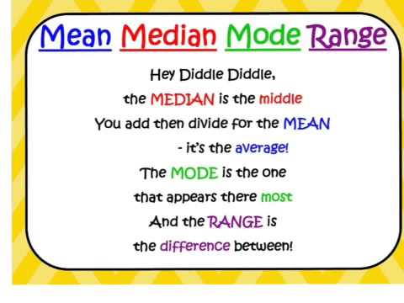
My Statistics Interactive Notebook
Name:
Class: 9-9
Teacher: Mr Evans
Term 3 Semester 2

Slide 2
A 10 Question Warm Up…

Slide 3
Find the median of the following numbers:-
  1) 3, 5, 6
  2) 2, 4, 1, 9, 10
  3) 9, 5, 12, 15, 21, 35, 2

Slide 4
Find the range of the following numbers:-
4) 50, 60, 70, 90
5) 22, 35, 20, 18, 27
6) 2, 1, 5, 9, 11, 3

Slide 5
Find the mean of these numbers:-
7) 2, 4, 5, 1
8) 5, 1, 2, 4, 2, 4,

Slide 6
Write down 3 numbers with a mean of 5
9.

Slide 7
Show me 5 numbers with a mean of 10
10.

Slide 8
Answers:-
5
4
12
40
17
10
3
3
Total of 15
Total of 50

Slide 9
Lesson Objectives
To be able to construct a Stem and Leaf Diagram, and use it to find the median and range

Slide 10
24
7
30
Date
Stem and Leaf Plots
EQ – What are Stem and Leaf Plots and why do we use them?
What are Stem and
Leaf Plots?
A Stem and Leaf Plot is a plot where each data value is split into a "leaf" (usually the last digit) and a "stem" (the other digits).
For example "32" is split into "3" (stem) and "2" (leaf).
The "stem" values are listed down, and the "leaf" values are listed next to them.
This way the "stem" groups the scores and each "leaf" indicates a score within that group.

Slide 11

Stem and Leaf Diagrams
How to Draw One:
1. Put the first digits of each piece of data in numerical order down the left-hand side
2. Go through each piece of data in turn and put the remaining digits in the proper row
3. Re-draw the diagram putting the pieces of data in the right order
4. Add a key

Slide 12
Stem and Leaf Diagrams
Here are the marks gained by 30 students in an examination:
63 58 61 52 59 65 69 75 70 54 57 63 76 81 64
68 59 40 65 74 80 44 47 53 70 81 68 49 57 61
Write the tens figures in the left hand column of a diagram.
These are the ‘STEMS’
4
5
6
7
8

Slide 13
Stem and Leaf Diagrams
Here are the marks gained by 30 students in an examination:
63 58 61 52 59 65 69 75 70 54 57 63 76 81 64
68 59 40 65 74 80 44 47 53 70 81 68 49 57 61
Go through the marks in turn and put in the units figures of each mark in the proper row. These are the ‘LEAVES’
8
4
5
6
7
8
3
1

Slide 14
Stem and Leaf Diagrams
Here are the marks gained by 30 students in an examination:
63 58 61 52 59 65 69 75 70 54 57 63 76 81 64
68 59 40 65 74 80 44 47 53 70 81 68 49 57 61
0 4 7 9
2 9 4 7 9 3 7
When all the marks are entered the diagram will look like this:
5 9 3 4 8 5 8 1
5 0 6 4 0
8
1 0 1
4
5
6
7
8
3
1

Slide 15
Stem and Leaf Diagrams
Here are the marks gained by 30 students in an examination:
63 58 61 52 59 65 69 75 70 54 57 63 76 81 64
68 59 40 65 74 80 44 47 53 70 81 68 49 57 61
0 4 7 9
2 3 4 7 7 8 9 9
1 1 3 3 4 5 5 8 8 9
Rewrite the diagram so that the units figures in each row are in order:
0 0 4 5 6
0 1 1
4
5
6
7
8

Slide 16
Stem and Leaf Diagrams
Here are the marks gained by 30 students in an examination:
63 58 61 52 59 65 69 75 70 54 57 63 76 81 64
68 59 40 65 74 80 44 47 53 70 81 68 49 57 61
0 4 7 9
2 3 4 7 7 8 9 9
1 1 3 3 4 5 5 8 8 9
Add a KEY:
0 0 4 5 6
5|2 = 52
0 1 1
4
5
6
7
8

Slide 17
Stem and Leaf Diagrams
Remember:
- Always put in a Key
- Always put your data in Order
Median:
- to work out the median, you must find the middle value
- if there are two middle values, you need the average
Range:
- to work out the Range, subtract the smallest number from the biggest

Slide 18
Stem and Leaf Diagrams
The stem & leaf diagram below shows the masses in kg of some people in a lift.
How many people were weighed?
What is the range of the masses?
Find the median mass.
Stem
Leaf
tens
3
1
4
units
Median is the mean of the 8th and 9th data values.
4
3
3
6
5
0
3
4
8
6
1
2
(a) 16 people.
7
2
2
7
(b) 86 – 31 = 55 kg
8
1
6
(c) 56 kg

Slide 19
Let’s try some together.
Use a Stem and Leaf Plot to represent the following data. Also find the Mean, Median, Mode and Range.
13, 11, 15, 24, 32, 25, 17, 21, 28, 31, 12, 25,
23, 16, 47, 28, 41, 24, 15, 16, 22, 43, 23
31, 14, 23, 17, 38, 28, 21, 124, 11, 25, 33,

Slide 20
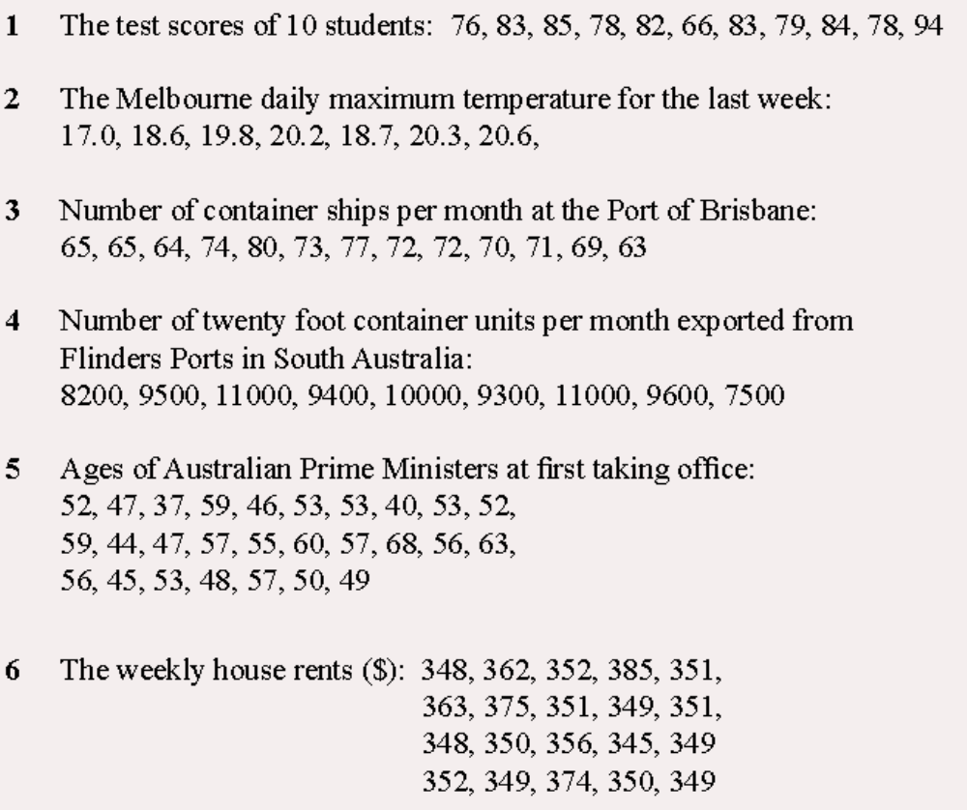
Try these on your own. Use your notes if you need to.
Use a Stem and Leaf Plot to represent the following data. Also find the Mean, Median, Mode and Range.

Slide 21
Complete your Summary ensuring you explain the process you use to find the measures of location.

Slide 22
Notes Review
24, 7 ,30
Date
Title
Essential question
Notes complete
Notes complete with colour and diagrams
Questions completed
Contents page filed in
Formula page filled in

Slide 23
Homework
Review your notes and write a summary answering the essential question.

